Slide 1

Course Id :INT 213

Slide 2
OPERATORS
An operator is a symbol that represents an operation that may be performed on one or more operands. For example, the 1 symbol represents the operation of addition. An operand is a value that a given operator is applied to, such as operands 2 and 3 in the expression 2 + 3. A unary operator operates on only one operand, such as the negation operator in - 12. A binary operator operates on two operands, as with the addition operator.

Slide 3
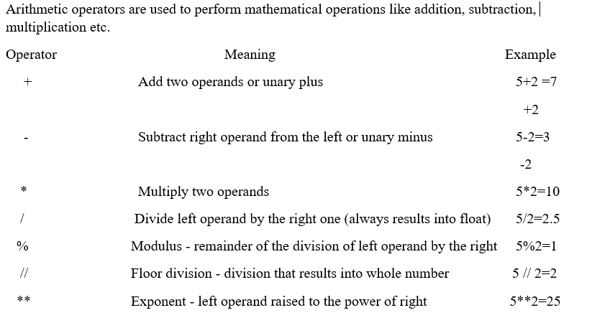
ARITHMETIC OPERATORS

Slide 4
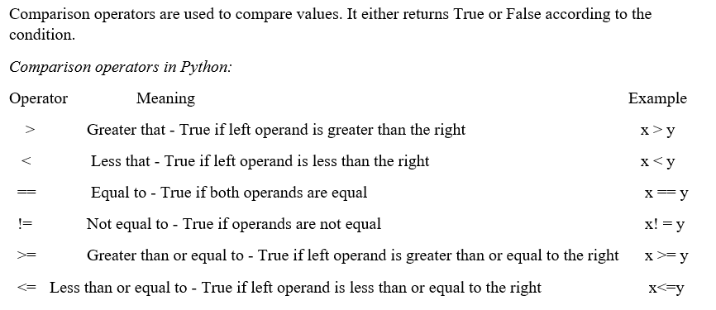
COMPARISON OPERATORS

Slide 5
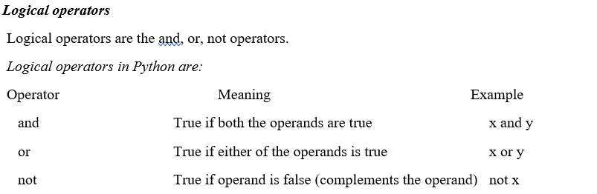
LOGICAL OPERATORS

Slide 6
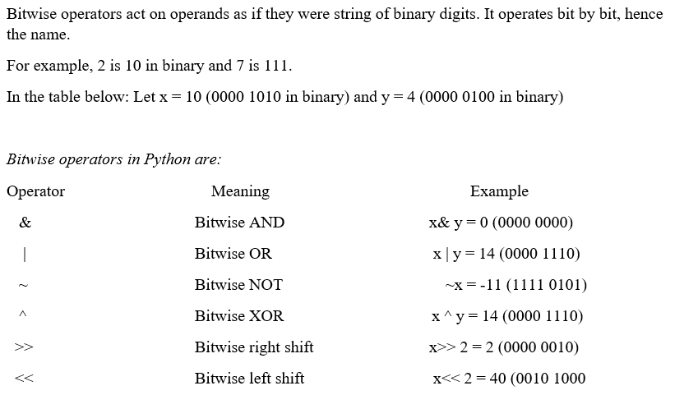
BITWISE OPERATOR

Slide 7
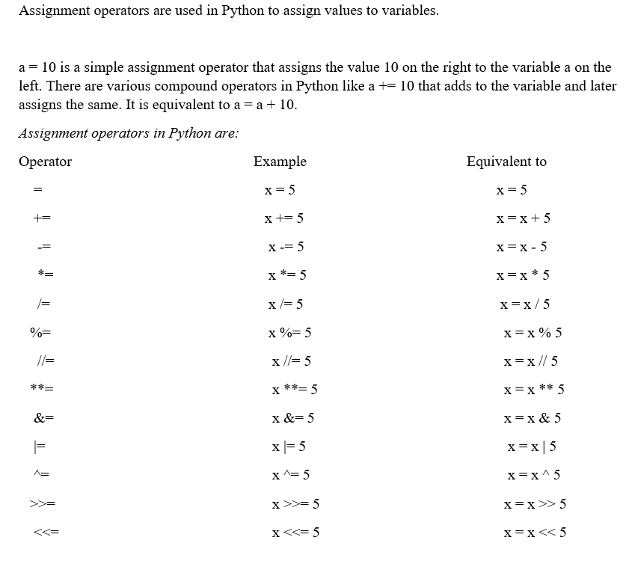
ASSIGNMENT OPERATORS

Slide 8
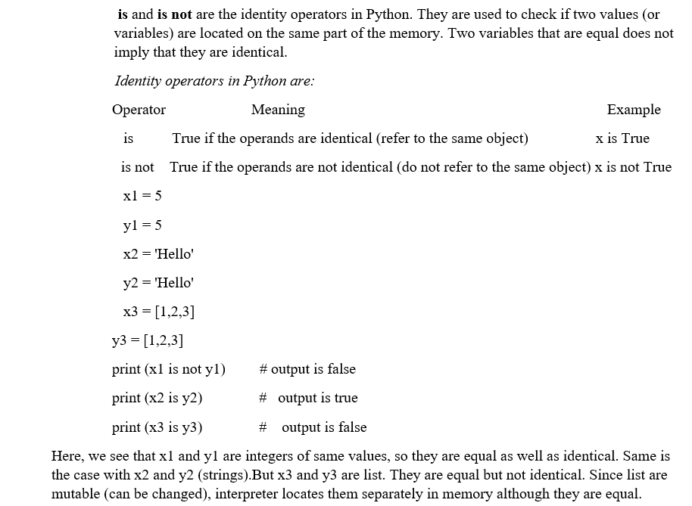
IDENTITY OPERATORS

Slide 9
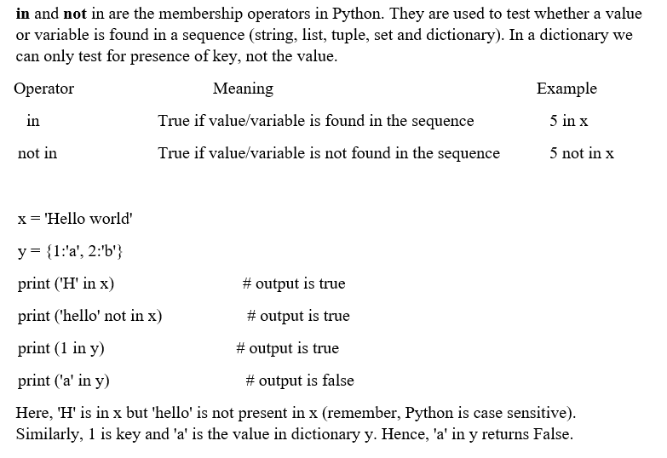
MEMBERSHIP OPERATOR

Slide 10
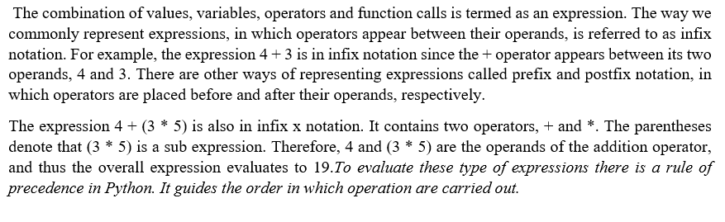
OPERATOR PRECEDENCE

Slide 11
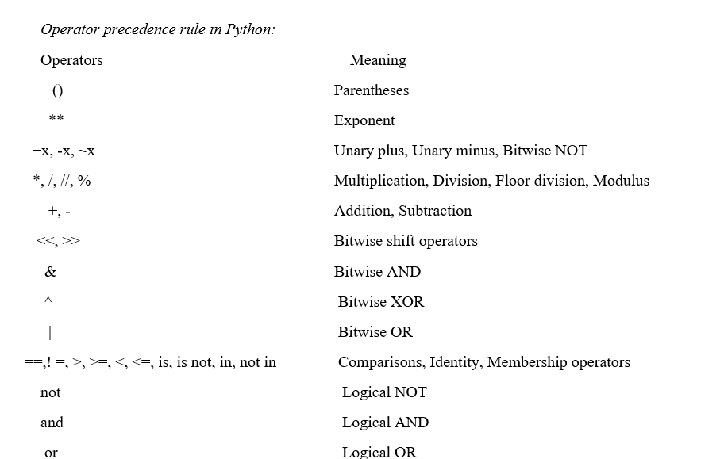

Slide 12
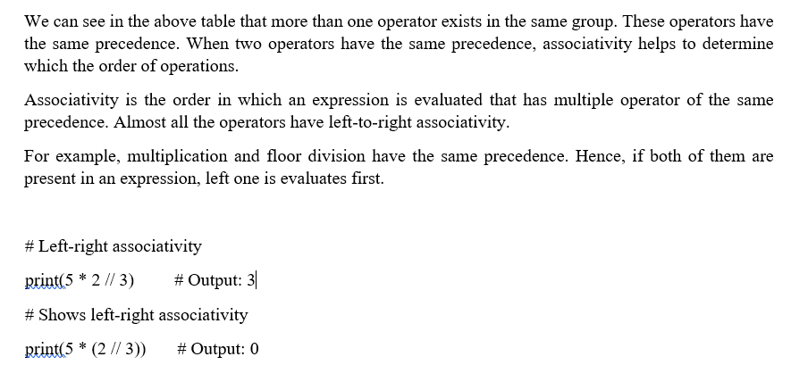
OPERATOR ASSOCIATIVITY

Slide 13
OPERATOR ASSOCIATIVITY
Exponentiation
right to left in case we are having more than one exponentiation operator.
2**2**2 = ?
2*2**2=?

Slide 14
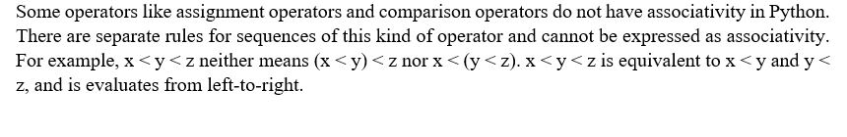
NON ASSOCIATIVE OPERATORS

Slide 15
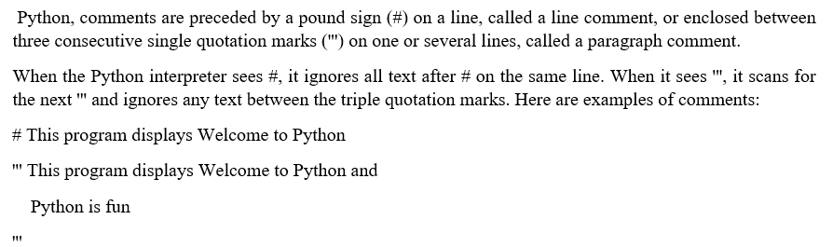
COMMENT

